Slide 1
America Expands
Chapters 7-9

Slide 2
Unit 2:
America Expands
Chapters 7-9
Big Question: Did America’s expansion create progress or problems? Evaluate the success of America’s westward expansion.

Slide 3
Industrial Revolution

Slide 5
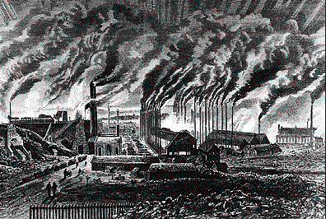
New England Factory Town
The Artist here is showing a New England factory town.

Slide 6
Growth of Cities
The Growth of cities in America from the years 1820-1840

Slide 7
Slums
The rapid growth of cities, combined with a shortage in housing led to the creation of slums in many cities.

Slide 8
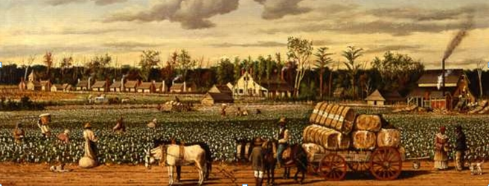
Plantation South vs. Commercial North
←North
South

Slide 9
The Missouri Compromise
The Missouri Compromise was needed because Missouri wanted to enter the US as a slave state. The problem was that this would upset the balance of power in the Senate between free and slave states, giving slave states more votes than free states. Northerners wanted Missouri to enter as a free state. Southerners threatened civil war if Missouri wasn’t entered as a slave state. To solve this issue, the Missouri Compromise allowed Missouri to be a slave state, but brought in Maine as a free state to keep the balance. Then, they drew a line and said all future states south of that line will be slave states and north of it will be free.

Slide 10
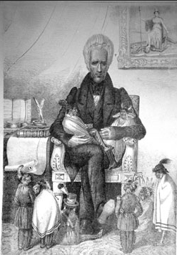
Jackson’s Indian Removal
President Andrew Jackson believed that Native Americans were in the way of white American expansion. He wanted to move them all west of the Mississippi River. As an excuse, he said that natives were America’s national “children” who needed to be protected from white aggression, and therefore moved to safety. In the image, Jackson is shown holding full grown Native Americans, meant to look like children.

Slide 11
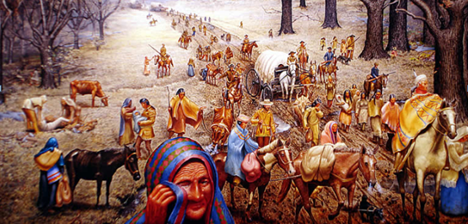
Trail of Tears
Tens of Thousands of Native Americans were forced at gunpoint out of their homes to move west of the Mississippi River. The American army moved the natives through harsh weather to their new lands. Thousands died on the journey.

Slide 12
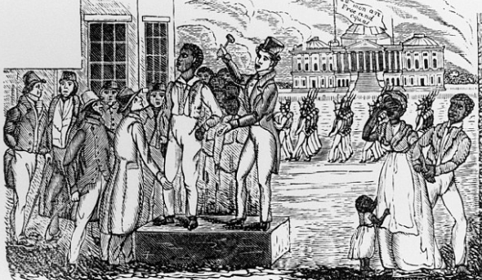
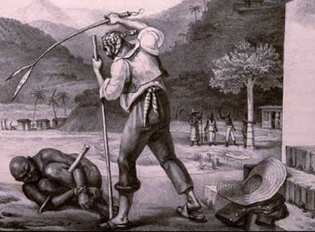
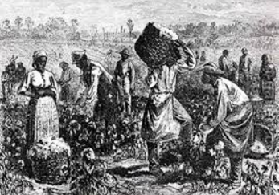
Slavery
Life under slavery in the American South was harsh and unforgiving. Enslaved African Americans endured wretched living conditions, hard labor, and brutal punishments. Families were broken up when owners sold off children or separated husbands and wives.

Slide 13
Abolition Movement Begins
Frederick Douglass, a runaway slave, who became an outspoken advocate for the emancipation of all slaves, once said of slavery “I have shown that slavery is wicked—wicked, in that it violates the great law of liberty, written on every human heart—wicked, in that it violates the first command of the Decalogue (10 Commandments)—wicked, in that it fosters the most disgusting licentiousness (immorality)—wicked, in that it mars and defaces the image of God by cruel and barbarous inflictions—wicked, in that it contravenes the laws of eternal justice, and tramples in the dust all the humane and heavenly precepts of the New Testament.

Slide 14
A Defense of Slavery
Thornton Strongfellow was a strong supporter of American slavery and wrote a defense of it that was based on the following points. In addition to arguing that slavery “civilizes” Africans, he said: “I propose, therefore, to examine the sacred volume briefly, and if I am not greatly mistaken, I shall be able to make it appear that the institution of slavery has received, in the first place,
1st. The sanction (permission) of the Almighty(God) in the Patriarchal age.
2d. That it was incorporated into the only National Constitution which ever emanated from God.
3d. That its legality was recognized, and its relative duties regulated, by Jesus Christ in his kingdom; and
4th. That it is full of mercy.

Slide 15
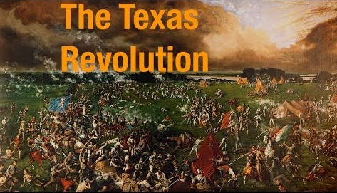
Did you know that Texas was once a part of Mexico and that the people there revolted and won their independence? Texas was once it’s very own country. Here’s the story: When Texas belonged to Mexico, many white American southerners began migrating there to begin plantations. When Mexico outlawed slavery, they revolted. They won their independence and soon after asked America to let them join as a state. 9 years later, the US made them a state. Mexico was not happy with the US.

Slide 16
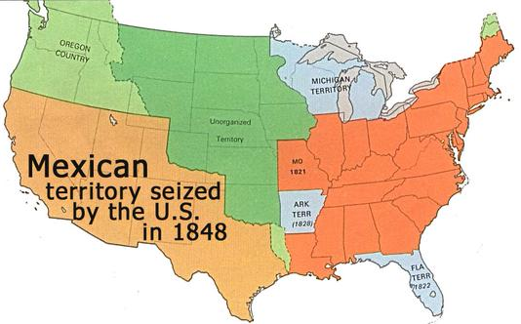
Mexican-American War
In the year 1848, the United States went to war with Mexico, over disputed territory in Texas. When the war was over, the United States was given thousands of square miles of formerly Mexican lands.

Slide 19
The Artist here is showing a New England factory town.

Slide 20
The Growth of cities in America from the years 1820-1840

Slide 21
The rapid growth of cities, combined with a shortage in housing led to the creation of slums in many cities.

Slide 22
Plantation South vs. Commercial North
←North
South

Slide 23
The Missouri Compromise
The Missouri Compromise was needed because Missouri wanted to enter the US as a slave state. The problem was that this would upset the balance of power in the Senate between free and slave states, giving slave states more votes than free states. Northerners wanted Missouri to enter as a free state. Southerners threatened civil war if Missouri wasn’t entered as a slave state. To solve this issue, the Missouri Compromise allowed Missouri to be a slave state, but brought in Maine as a free state to keep the balance. Then, they drew a line and said all future states south of that line will be slave states and north of it will be free.

Slide 24
Jackson’s Indian Removal
President Andrew Jackson believed that Native Americans were in the way of white American expansion. He wanted to move them all west of the Mississippi River. As an excuse, he said that natives were America’s national “children” who needed to be protected from white aggression, and therefore moved to safety. In the image, Jackson is shown holding full grown Native Americans, meant to look like children.

Slide 25
Trail of Tears
Tens of Thousands of Native Americans were forced at gunpoint out of their homes to move west of the Mississippi River. The American army moved the natives through harsh weather to their new lands. Thousands died on the journey.

Slide 26
Life under slavery in the American South was harsh and unforgiving. Enslaved African Americans endured wretched living conditions, hard labor, and brutal punishments. Families were broken up when owners sold off children or separated husbands and wives.

Slide 27
Abolition Movement Begins
Frederick Douglass, a runaway slave, who became an outspoken advocate for the emancipation of all slaves, once said of slavery “I have shown that slavery is wicked—wicked, in that it violates the great law of liberty, written on every human heart—wicked, in that it violates the first command of the Decalogue (10 Commandments)—wicked, in that it fosters the most disgusting licentiousness (immorality)—wicked, in that it mars and defaces the image of God by cruel and barbarous inflictions—wicked, in that it contravenes the laws of eternal justice, and tramples in the dust all the humane and heavenly precepts of the New Testament.

Slide 28
A Defense of Slavery
Thornton Strongfellow was a strong supporter of American slavery and wrote a defense of it that was based on the following points. In addition to arguing that slavery “civilizes” Africans, he said: “I propose, therefore, to examine the sacred volume briefly, and if I am not greatly mistaken, I shall be able to make it appear that the institution of slavery has received, in the first place,
1st. The sanction (permission) of the Almighty(God) in the Patriarchal age.
2d. That it was incorporated into the only National Constitution which ever emanated from God.
3d. That its legality was recognized, and its relative duties regulated, by Jesus Christ in his kingdom; and
4th. That it is full of mercy.

Slide 29
Did you know that Texas was once a part of Mexico and that the people there revolted and won their independence? Texas was once it’s very own country. Here’s the story: When Texas belonged to Mexico, many white American southerners began migrating there to begin plantations. When Mexico outlawed slavery, they revolted. They won their independence and soon after asked America to let them join as a state. 9 years later, the US made them a state. Mexico was not happy with the US.

Slide 30
In the year 1848, the United States went to war with Mexico, over disputed territory in Texas. When the war was over, the United States was given thousands of square miles of formerly Mexican lands.

Slide 31
Lewis and Clark
The Lewis and Clark Expedition from May 1804 to September 1806, also known as the Corps of Discovery Expedition, was the first American expedition to cross the western portion of the United States.

Slide 32
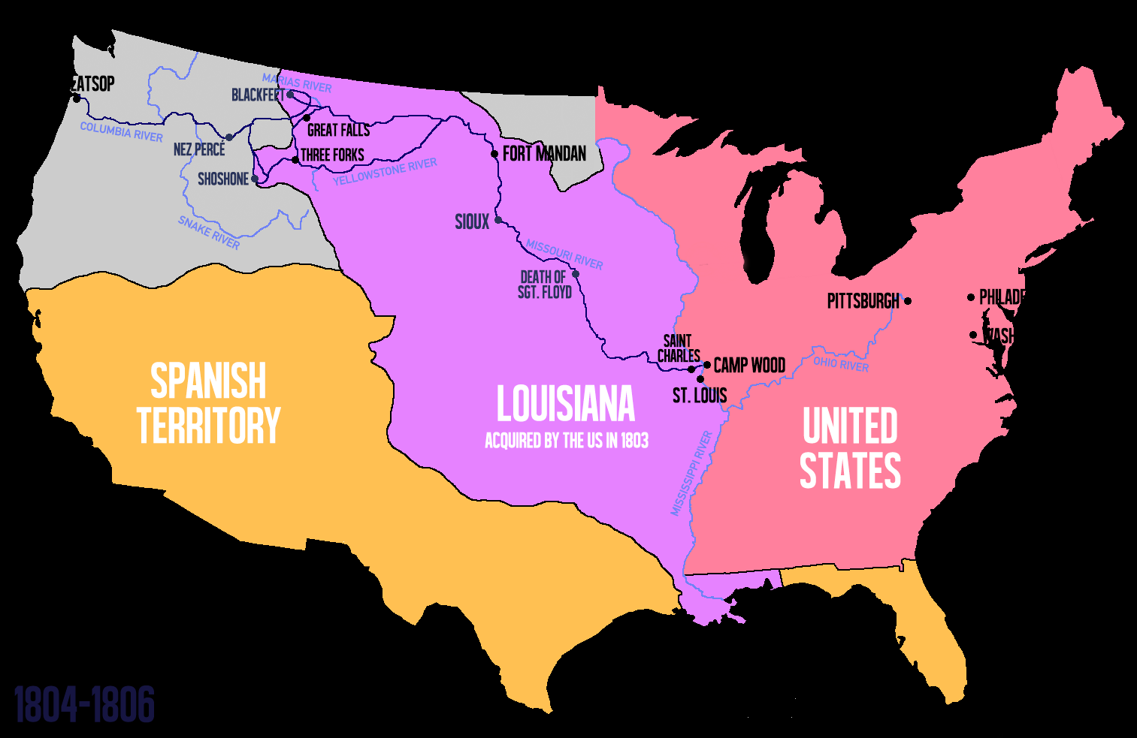

Slide 33
Monday, December 2nd 2019
Do Now: What does the word progress mean to you? Define it in your own words and then answer the following questions.
What would political progress look like?
What would social progress look like?
What would economic progress look like?

Slide 34
Let’s take a look at the big question
Did America’s Expansion create progress or problems?
What word do we need to truly define in order to answer it?
Take 30 seconds and see if you can figure out which is the key word

Slide 35
Figuring Out What Progress Looks Like
In order to figure out what progress looks like, we need to first discuss…
the problems.
Take 5 minutes: What are the Economic, Social, and Political Problems in America during the time periods we have discussed so far in class? (stuff from the first report period, this report period, and last class’s gallery walk→ BEFORE BREAK)
Write them down in your notes.
Economic Problems-
Social Problems-
Political Problems-
HINT: think about slavery, economy, land availability, rights, voting, etc.

Slide 36
Progress
What does progress mean to you?
Now, we have to define what it means in terms of the question:
Was westward expansion necessary for America to progress as a nation?
So…what would have to happen in America, in the time that we’re studying, in order for America to be making progress?
Take 2 minutes and write what progress would look like in the early 1800s.
HINT: think about slavery, economy, land availability, rights, voting, etc.

Slide 37
What would progress look like
NOTE: keep this chart and fill it out at the end of each class, to help you write your essay at the end of the unit
Let’s go over it together

Slide 38
Keeping Track
You need to Add to this chart, and you need to turn it in at the end of the unit with your essay
You’re tracking the events and/or topics that we cover in class
What happened in those events (major takeaways)
How that impacted progress, based on your definition of progress above.

Slide 39
Let’s look at the first industrial revolution

Slide 40
Industrialization Big Question: What were the political, economic, and technological effects of Industrialization?

Slide 41
Lesson Outcome
What were the economic effects of the industrial revolution?
Explain the political effects of the Industrial Revolution?

Slide 42
Industrialization: Definition
Industry: a branch of trade or manufacture…(business, commerce, production)
Industrial: of or relating to industry (an area of business)
The suffix “ize”: to become or to make
Put them together: Industrialize
To become industrial
To create factories, businesses, production

Slide 43
Industrialization
Most Americans were…
However, US needed to begin making their own goods, instead of…
buying them all from other countries
Americans begin to invent machines to produce goods …
…faster
The American factory system is created between 1793 and the 1820s.
farmers

Slide 44
Reading the article- (library atmosphere)
Read and annotate the article on the Industrial Revolution
Annotate in the margins 1-5 words per paragraph
Answer the questions at the bottom when finished

Slide 45
Tuesday, December 3, 2019
Do-Now: Where did industrialization take place? Where did it not take place? Why?
If you were absent yesterday, retrieve the handout from “Monday” and begin reading/annotating and answering the questions

Slide 46
(Tuesday, 12.3.19)
Complete the T-Chart that was provided yesterday (if absent, attached to handout)
Economic-anything that deals with money, jobs, employers/employees, wages, businesses, etc.
Political-anything that deals with power, laws, wars, government

Slide 47
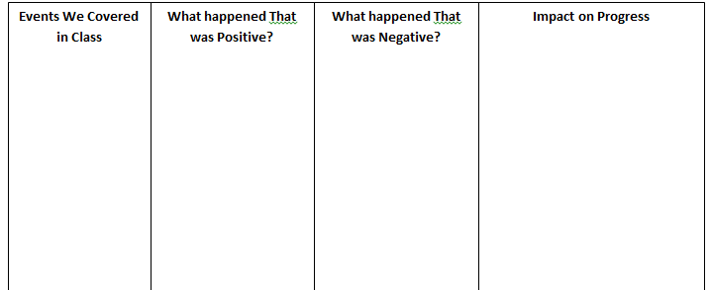
As a group
Begin filling in the tracker.
What you don’t complete becomes a part of your HW

Slide 48
Effects of Industrialization

Slide 49
Analyzing historical evidence
While researching (reading) you need to draw conclusions
Annotate (1-5 words)
Keep your framework in mind:
What’s the framework for this unit?
Progress
So, as we read today, we are looking to see if progress is being made or impeded (delayed/prevented/hindered).

Slide 50
Get with students who read your similar article
In your groups discuss the progress or lack or progress that you read about.
Track this in your notes.

Slide 51
The Different Economies- Copy in notebooks
Northern Commercial Economy
Paid workers
Goods are bought and sold with cash
Cities
Industry: Factories and manufacturing
Southern Plantation Economy
Slaves (unpaid)
Goods traded directly off boat at plantation
Rural/agricultural
No Industry: import finished goods

Slide 52
Missouri Compromise Big Question: How did the Missouri Compromise temporarily solve the problem between free and slave states?

Slide 53
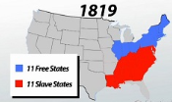
Welcome to 1819
Everything is balanced
Everything is “Great”

Slide 54
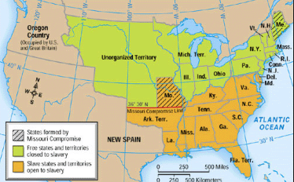
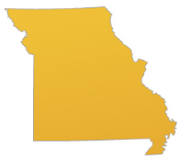
Hi, I’m Missouri
These student(s) are Missouri
They’d like to mess everything up
They want to become a slave state

Slide 55
The Tallmadge Amendment
It seemed as if Missouri would become a slave state with no problems until Mr. James Tallmadge amended the admission of Missouri.
He said Missouri can come in as a state, but also added the following:

Slide 56
Let’s look at some arguments
Arguments in support of Missouri becoming a slave state
Arguments in opposition of Missouri becoming a slave state
Read individually
Later we will: Discuss in groups and Present Arguments

Slide 57
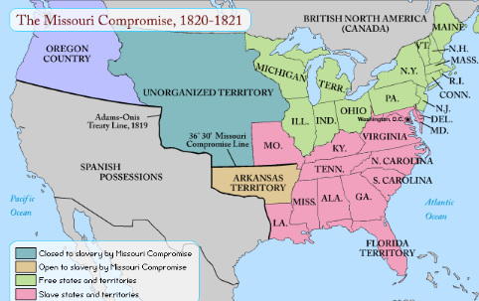
The Missouri Compromise (Notes)
What makes the South Happy
Missouri gets to become a slave state
What makes the North Happy
Maine is added to the union as a free state
Keeps the number of free and slave states in the union equal
The balance of power in the Senate is preserved
What makes both sides happy, temporarily?
A line is drawn South of Missouri
States that come in south of that line=slave
States that come in north of that line=free

Slide 58
Why is the balance of power in the Senate important moving forward?
Based on what the map has shown us, why will that be an issue as Americans expand westward and create more states?

Slide 59
Andrew Jackson Big Question: What are Jackson’s 3 most infamous policies as president?

Slide 60
Who Would You Vote For? Why?
Candidate 1
Candidate A
-Champion of the Common Man – relates to the people, self-made success.
-Fought for the rights of the “working man.”
-Spreads democratic values and rights to more citizens.
-Against big business and the rich. -For a limited government.
-Fights against corruption.
-A National War hero.
-Argued that all white men have the right to liberty.
-Destroyed an economic institution of greed and corruption.
-Enemies say he acts like a king/tyrant
-Used more veto power than any other president.
-Went against the Supreme Court
-Fired over 200 experienced government employees.
-Abused the constitution and used it to fit his aims.
-Accused of spreading corruption in the government.
-Defied the power and authority of other branches of government.
-Slaughtered Native Americans and stripped them of land/rights/dignity
-“Killed” an important economic institution, later creating an economic recession.

Slide 61
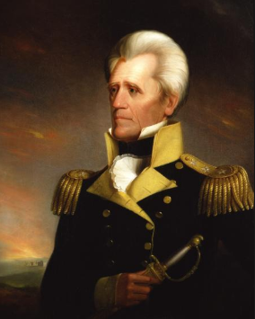
Who Were these candidates?
They’re the same person

Slide 62
Who was Andrew Jackson
Child of immigrants, orphaned at 12
Poor
Became wealthy on his own (super $$$)
Slave Owner
War Hero from the War of 1812
Lost election of 1824 over corruption
Claimed to be man of the people
“I’m just like you, I’m a common man”
Won the election of 1828 by a landslide
7th president of the US

Slide 63
Read/annotate
Read the article on Jackson’s policy of being the “common man.”
Annotate 1-5 words per paragraph
Summarize in the box at the bottom
Do not do the back page with the 4 questions.

Slide 64
Mob Rule?
Jackson was elected when the “common man” was allowed to vote.
Let’s take a look at a painting of his inaugural ball
What is happening in this picture?
There were so many “common people” that attended the white house, that he had to put the punch bowls out on the lawn to get rid of the crowds inside.

Slide 65
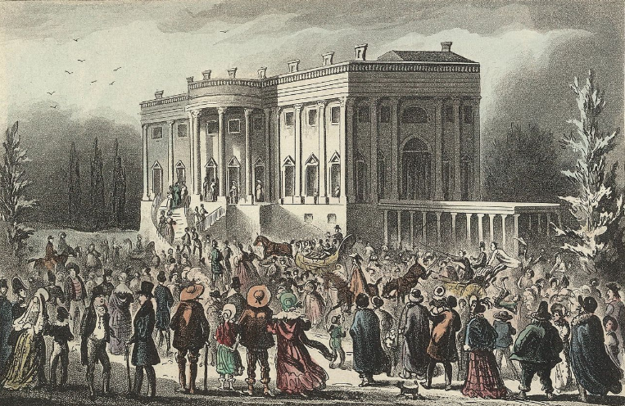
Mob Rule?
Jackson was elected when the “common man” was allowed to vote.
Let’s take a look at a painting of his inaugural ball
What is happening in this picture?
There were so many “common people” that attended the white house, that he had to put the punch bowls out on the lawn to get rid of the crowds inside.

Slide 66
Spoils System
To the Victor belong the spoils…
This comes from ancient times
When one empire defeated a city, the soldiers would get to loot the city.
Gold, silver, jewels, food, slaves
These were called the spoils of war
Similarly, when Jackson won the presidency, he will institute something called the Spoils System
Let’s find out what that means

Slide 67
Spoils System Reading
Read and annotate 1-5 words per paragraph
Then answer the four questions at the bottom

Slide 68
The Questions
Go back to the first paragraph: What does “to the victor belong the spoils” mean to Jackson and his followers?
Define the Spoils System, according to paragraph 2.
According to paragraph 3, did Jackson follow through with his “common man” promises?
What are the criticisms of Jackson’s Spoils system?

Slide 69
Blank Side of Index Card
#21 Missouri Compromise Big Question: How did the Missouri Compromise temporarily solve the problem between free and slave states?

Slide 70
Blank Side of Index Card
#22 Jackson and Indian Removal Big Question: How was Jackson’s actual policy different from what he had previously said?

Slide 71
Blank Side of Index Card
#23 The Mexican-American War Big Question: Why was the Mexican-American war controversial?

Slide 72
II. Manifest Destiny
What does it mean???
Let’s break down the word:
Manifest =
Destiny =
Let’s put them together =
It was obvious that America’s fate was to…
Who/what gave them this right?
Americans believe God Gave them this right
To become obvious
Fate
Obvious Fate
Expand WEST to the Pacific Ocean

Slide 73
II. Manifest Destiny, continued
Definition of Manifest Destiny:
God made it America’s obvious fate to expand west from the Atlantic Ocean to the Pacific Ocean

Slide 74
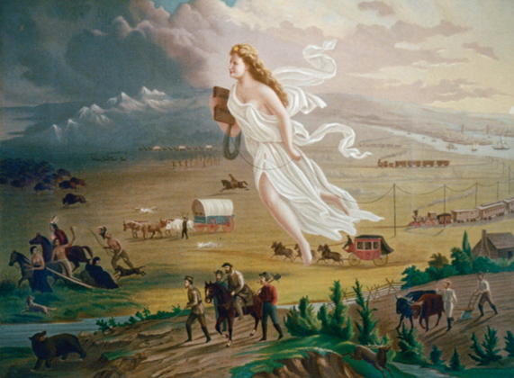
Image Analysis
Take 2 minutes and write down what you are seeing in this image
Use only your eyes, do not analyze
Hint, divide the image into four quadrants
For example:

Slide 75
Image Analysis
Now, take 2 more minutes
What is the image saying about Manifest Destiny?
Hint, divide the image up into four quadrants

Slide 76
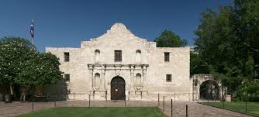
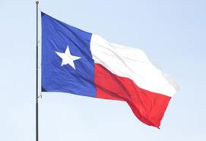
III. Run-up to War with Mexico
A. After bloody revolution, Texas (not part of U.S. yet) becomes independent from Mexico
1. ex. Mexicans kill all Texans at the Alamo
2. “Remember the Alamo” becomes Texans’ rally cry
B. There’s a debate in the U.S. whether to add Texas as a new state
1. Slave states in the south wanted it added
2. Free states in the north don’t

Slide 77
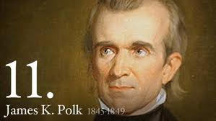
C. Texas become the 28th state in 1845
D. President Polk wants the U.S. to continue to expand westward

Slide 78
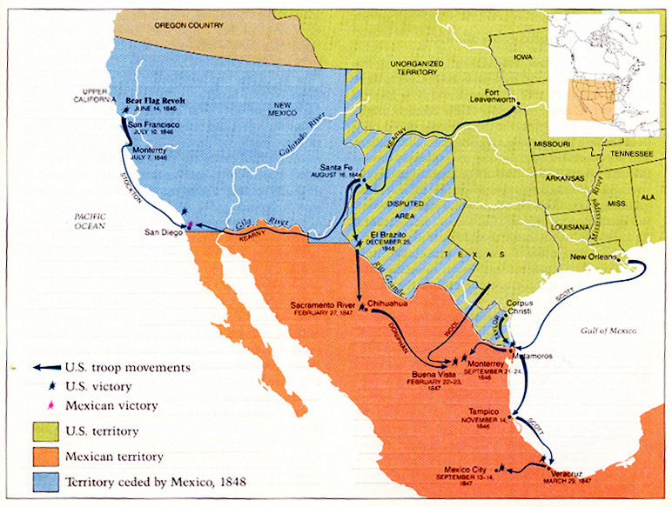

Slide 79
C. Texas become the 28th state in 1845
D. President Polk wants the U.S. to continue to expand westward
1. Thinks that war with Mexico could add even more land
E. Many agree with goal to expand, but public opinion split over fighting for it

Slide 80
IV. US Provokes a War
Polk orders US soldiers to protect a river, in disputed territory
The US general sends troops across the river to provoke the Mexicans
The Mexicans retaliate and fire upon the American soldiers
Polk goes to congress and says that the Mexican Army has attacked the American army, unprovoked, on American soil
Congress declares war on Mexico…
Now it’s a “justified” war, they attacked first

Slide 81
V. The Mexican American War
The United States wins the war relatively easily.
US invades Mexican territory
Invaded west to California
Invaded South into present day Mexico
Conquered the Mexican Capital of Mexico City
When the war was over, the Treaty of Guadalupe Hidalgo was signed
Ended the War
Gave USA a ton of Mexican land
USA paid $15 million for it.

