Slide 1

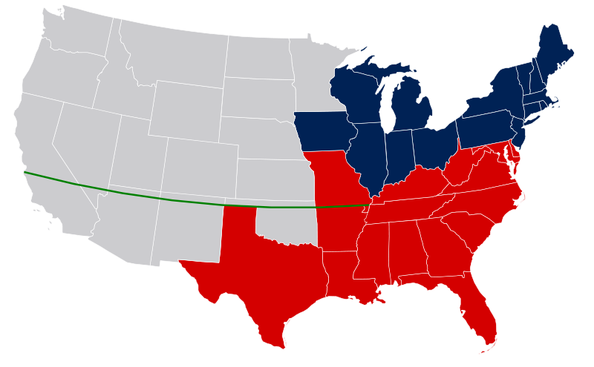
I. California Problem
There was a gold rush in California in 1849 (millions moved there)
There are an even number of free/slave states in the US
California applies for statehood as a free state (anybody know why?)
Why is that a problem? (let’s look at a map)

Slide 2
II. Civil War seems imminent
Both sides (north and south) threaten war over California
A compromise is needed (again)
  Like the ___________ Compromise we learned about before.

Slide 3
III. Compromise of 1850
North Gets
South Gets
California as a Free State
  This will end the balance of power between free and slave states in the Senate…forever!
Strict Fugitive Slave Laws
Utah and New Mexico Territories will have an “open mind” about slavery

Slide 4
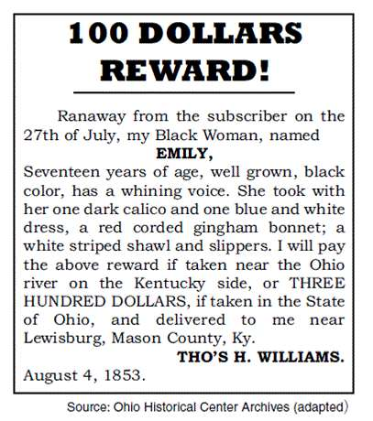
Document Analysis
What is the document about?
How would Northerners feel about this? Southerners? Explain in 1 sentence.

Slide 5
Guess What?
Northerners are going to hate this law for many reasons
They are going to go against it in one of 3 ways
  Personal Liberty Laws
  The Underground Railroad
  Antislavery literature like “Uncle Tom’s Cabin”

Slide 6
Do-Now Review
What was the Fugitive Slave Act?
  Forcibly compelled citizens to assist in the capture of run-away slaves
How did Northerners Respond?
  Personal Liberty Laws
  Underground Railroad
  Anti-Slavery Literature
Why do North and South hate each other even more afterwards?
  The beginnings of sectionalism

Slide 7
Sectionalism- (take notes on handout)
After the 1850s, the United States was divided into 2 sections (North and South)
Sectionalism is when the North and South really started to hate each other

Slide 8
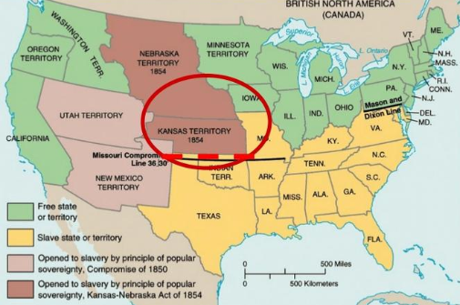
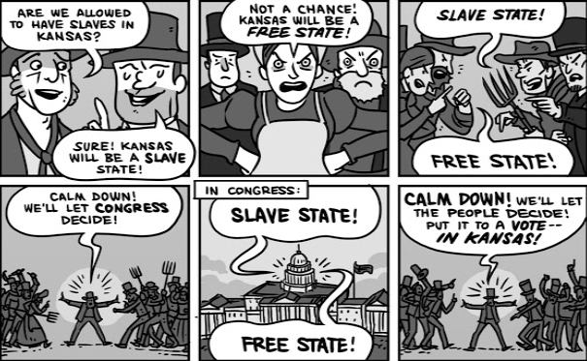
The Kansas Issue

Slide 9
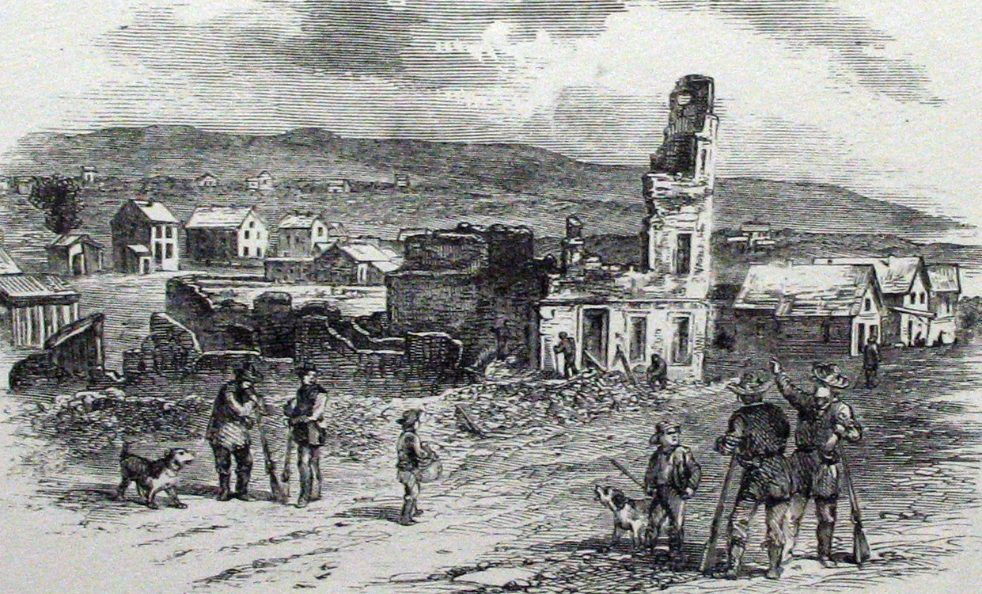
“Bleeding Kansas”
1855-1859
56 Dead
Lawrence, KS, after the “Sack of Lawrence” by proslavery settlers

Slide 10
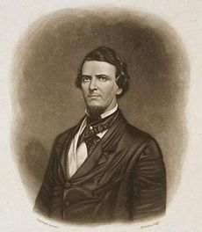
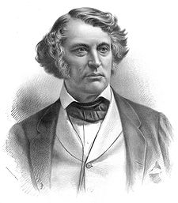
Brooks/Sumner Incident
"breakdown of reasoned discourse"
(1856)
vs.
Rep. Preston Brooks (SC)
Sen. Charles Sumner (MA)

Slide 11
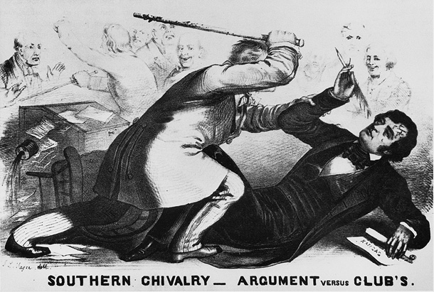
SLAP!

Slide 12
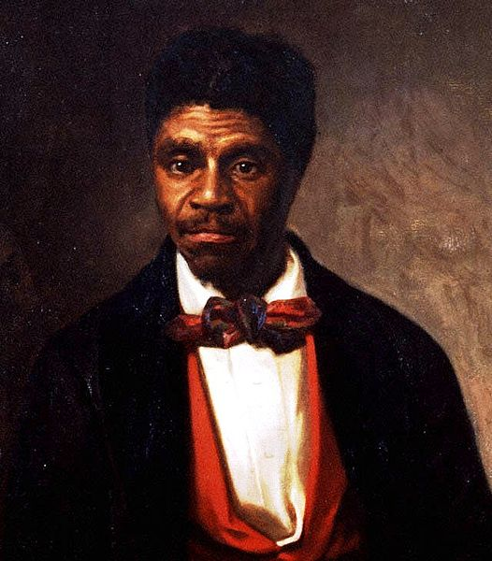

Dred Scott v. Sandford
(1857)
FACTS OF THE CASE:
Dred Scott, a slave, lived with his “master” in free territory for two years.
Scott claimed this made him a free man.

Slide 13



Dred Scott v. Sandford
(1857)
THE DECISION:
People of African descent (incl. Scott) could not be U.S. citizens.
Congress can’t forbid slavery in federal territories (violation of property rights)
  Ergo, the Missouri Compromise is Unconstitutional

Slide 14
Quote Analysis
“A house divided against itself cannot stand. I believe this government cannot endure permanently half slave and half free.” — Abraham Lincoln, 1858
  In your own words, what is Lincoln saying here? (see if you can incorporate the word “sectional” or “sectionalism” into your answer)

Slide 15
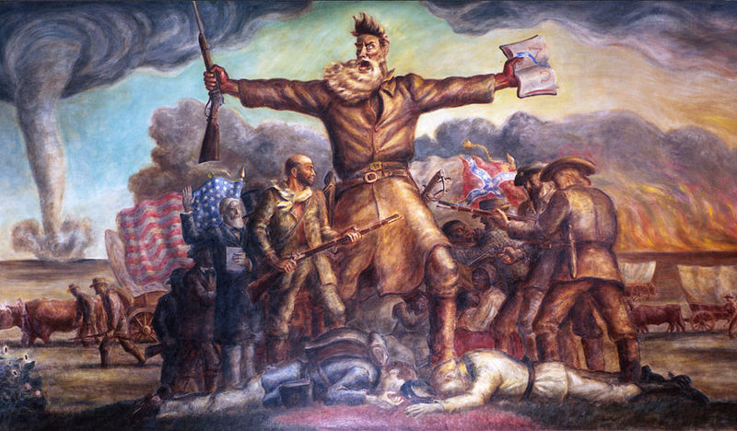
John Brown (Violent Abolitionist)
John Steuart Curry, “Tragic Prelude,” 1937-1941

Slide 16

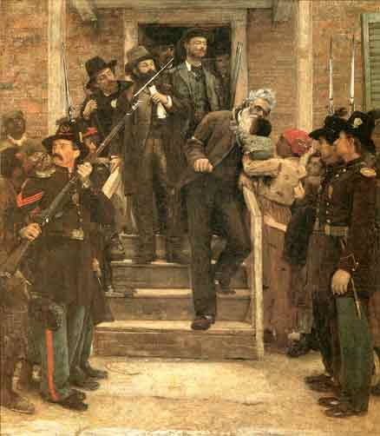
John Brown’s Raid
(1859)
OBJECTIVE:
  Seize a federal arsenal
    Harpers Ferry, VA
TREASON
  Tried, Convicted, Executed
  Different reactions in North and South

Slide 18
Paranoia
NORTH: “Slave Power” Conspiracy
The South wants to spread slavery throughout the nation
SOUTH: North plans to destroy Southern slavery by igniting slave revolts.

Slide 19
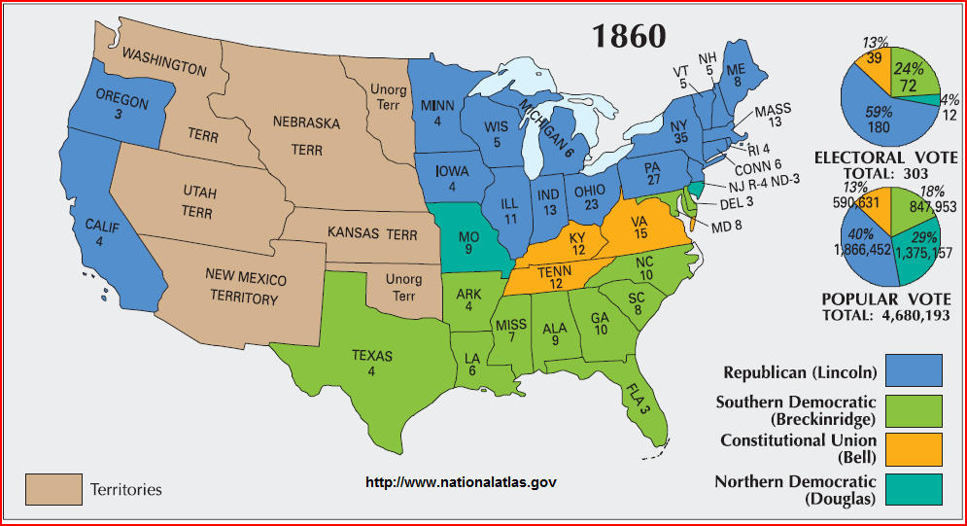
1860 Presidential Election

Slide 20
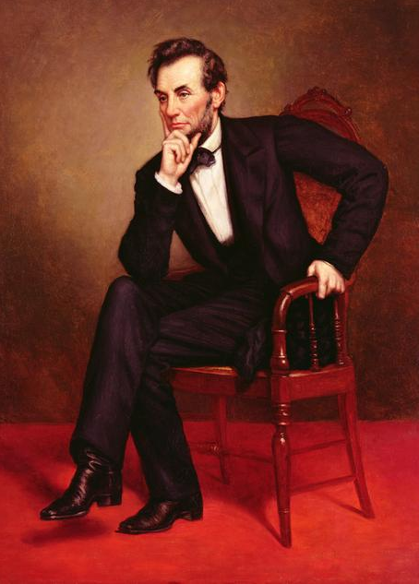
Abraham Lincoln
(R-IL)
Sixteenth President of the U.S.
1861-1865
Democratic Party split
Election prompted secession of states in the Deep South

Slide 21
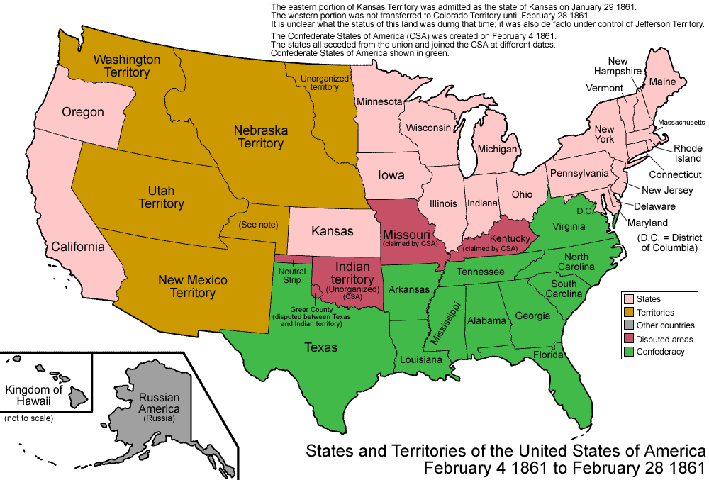
Secession

Slide 22
sEcede vs sUceed
What’s the difference
  Hint hint: different than succeed
  sEcede=to break off; to leave; to create your own country
    sUceed=winning

Slide 23
As the 1860 presidential election approached, the Republican Party adopted an antislavery platform and nominated Abraham Lincoln as its candidate. Although he received less than 40% of the popular vote, Lincoln won the election, which proved that the North was in command of national affairs. The leaders of the South were convinced that the welfare of their states, and the institution of slavery, were in jeopardy. In short order, they began to secede from the Union. South Carolina withdrew first and was soon joined by Mississippi, Florida, Alabama, and Georgia and then later by Louisiana, Texas, Virginia, Arkansas, North Carolina, and Tennessee. These states formed a new government, the Confederate States of America, on February 4, 1861, and elected Jefferson Davis as their president. A month later on March 4, when Lincoln was inaugurated as the 16th president of the United States, he made it clear in his inaugural address that no state had the right to leave the Union. The situation was becoming untenable for both sides.

Slide 24
What was the impact of Lincoln’s Election on America?

Slide 25
Do Now
This is the oath (promise) that every president must make in order to take office.
  "I do solemnly swear (or affirm) that I will faithfully execute the Office of President of the United States, and will to the best of my Ability, preserve, protect and defend the Constitution of the United States.“
The ability for a state to secede is not in the constitution…what should Lincoln do according to this oath?

Slide 26
Abraham Lincoln Big Question: What is his goal at the beginning of the War? Why did he say a “house divided cannot stand”?

Slide 27
It’s Inauguration Day, 1861
Lincoln will be sworn in as the 16th president of the United States
7 Southern states have seceded and formed their own country, The Confederate States of America
What issues does he have to deal with right away?
  Secession
  Slavery debate
Which one would you deal with first?
What do you think his inaugural speech (aka inaugural address) will be about?

Slide 28
Is Secession Even Legal?
Do States have the right to secede and leave the union whenever they want?
  Lincoln says no. Why would allowing secession be a bad idea?

Slide 29
The Inaugural Speech
It’s one last desperate attempt to keep the country together
  He’ll give some concessions to make the South feel better, but…
  He’ll also make some threats
  Let’s read to find out.
    Annotate each portion and…
    Answer the questions below each one
    We’ll discuss in a bit.

Slide 30
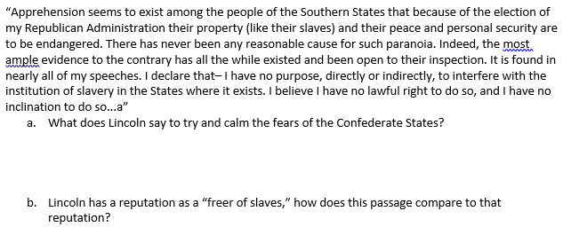
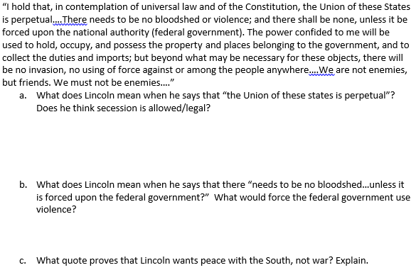

Slide 31


Slide 32
Prediction
What are Lincoln’s goals on the day he takes office?

Slide 33
The Civil War Begins
In the meantime, between his inaugural address and the letter you’re about to read, the Civil War has begun

Slide 34
Fort Sumter
You already know the following:
  After Lincoln was elected 7 Southern states…
After the Southern States seceded, the first thing they did was take over old Federal Institutions
  Government buildings, post offices, and military installations
By April of 1861, most Federal military fortresses in the South were controlled by the Confederacy…except Fort Sumter

Slide 35
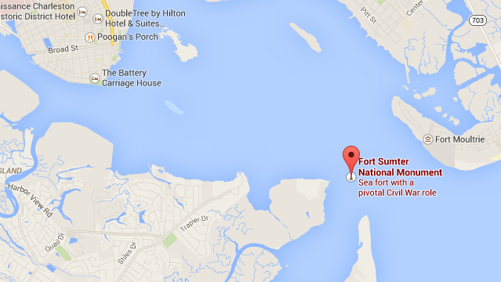
Fort Sumter
Fort Sumter sat at the mouth of the harbor in Charleston
  Whoever controlled it, controlled the ships that could go in and out of the harbor at Charleston

Slide 36
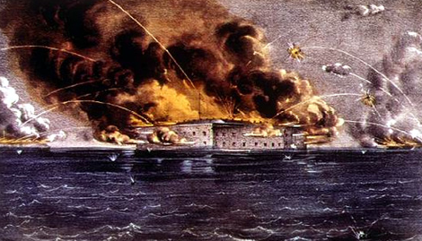
Fort Sumter
Fort Sumter sat at the mouth of the harbor in Charleston
The Dilemma:
  The South demanded that it be abandoned by the Union
  The Union Refused
  On April 12, 1861, the Confederates opened fire on the Fort and bombarded it for 2 days.
The Civil War would now begin

Slide 37
Lincoln’s Reputation
What is Lincoln’s reputation, historically speaking, regarding slavery?

Slide 38
Read Lincoln’s Letter to Horace Greely
Annotate and answer the questions that follow each portion of the letter.
DO NOT DO THE BOTTOM PARAGRAPH YET

Slide 39
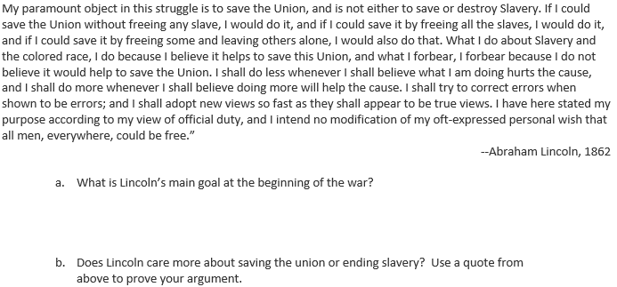
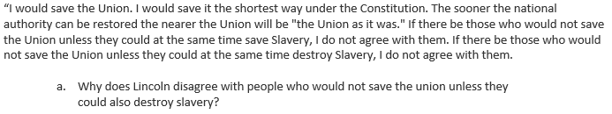
Question Discussion:

Slide 40
Lesson 4
1863 Turning Point
  Emancipation Proclamation
  Gettysburg

Slide 41
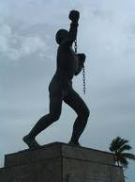
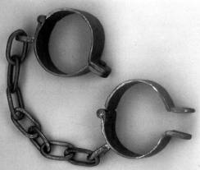
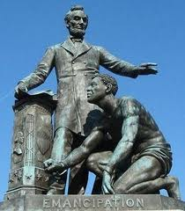
Do Now: What is happening in each picture. Write a full sentence describing each image. Then…answer the bottom Q.
#1 #2 #3
What do they have in common?

Slide 42
Blank Side of Index Card
#26 Emancipation Proclamation Big Question: Where were slaves actually freed from the Emancipation Proclamation?

Slide 43
Blank Side of Index Card
#27 Battle of Gettysburg Big Question: How did the result impact the Civil War?

Slide 44
Lesson Outcome
Compare and contrast the misconception of the Emancipation Proclamation with its reality.
Explain how Gettysburg impacted the Civil War

Slide 45
The Background
During the first two years of the war the Union had been mostly losing battles
Lincoln saw that emancipating or freeing the slaves would hurt the Confederate cause
There were two problems with the idea of emancipation
  If Lincoln freed all slaves, the Border States (slave states in the Union) might secede
  Since the Union was losing a lot, it might look like a last ditch, desperate attempt to win the war.

Slide 46
And then…Antietam
The South attempted to invade the North and put pressure on Washington D.C.
The Battle of Antietam was a huge victory for the North
This would allow the emancipation proclamation to be made
  Would no longer look desperate

Slide 47
Common Misconceptions about the Emancipation proclamation
It abolished slavery in the US
It freed all slaves
It freed slaves in the union too
The document only dealt with slavery

Slide 48
The Early Civil War
For the first two years of the Civil War, the Union loses most of its battles against the South
  Except for a few (like Antietam)
However, 1863 would be a major turning point

Slide 49
Gettysburg
The Confederates again invaded the North, in an attempt to put pressure on D.C. again
  Maybe they would go to Philly or NYC too.
160,000 soldiers would fight at this small town in PA for 3 days
Bloodiest battle of Civil War
Would be a turning point for the Union
  After this battle, the Union mostly wins battles

Slide 50
Lesson Recap
Where did the Emancipation Proclamation actually free slaves?
  Slaves were only freed behind enemy lines, in the Confederacy.
How did Gettysburg impact the Civil War?
  It drastically weakened the South and guaranteed the North’s safety from another southern invasion.

