Slide 1
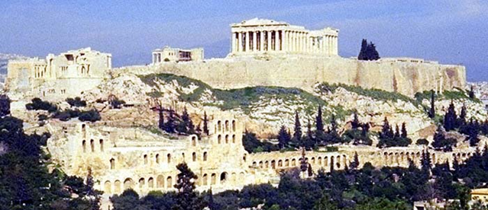
Lesson Essential Question
How did the differences between Sparta and Athens influence Greek and world culture?

Slide 2
-Answer the following question on the back of your counterargument paper.
What city-state did you select (Athens or Sparta) and what is the main reason as to why you chose that particular one?

Slide 3
Sparta vs. Athens Project:
Let’s practice some of our reasons/evidence with contrasts…
1. Basic reason: Sparta has a strong army
Fully-developed counterargument showing the contrasting relationship: Be protected by the strongest army in Greece. Spartan men learned to fight from an early age while being taught reading and writing, whereas Athens just teaches their boys science, math, and philosophy.

Slide 4
Sparta-Athens Project
Let’s practice some of our reasons/evidence with contrasts…
2. Basic reason: Athens is smart!
Fully-developed counterargument showing the contrasting relationship : Come to Athens where you can learn philosophy, science, medicine, and math. Our rivals in Sparta haven’t come up with anything besides war.

