Slide 1
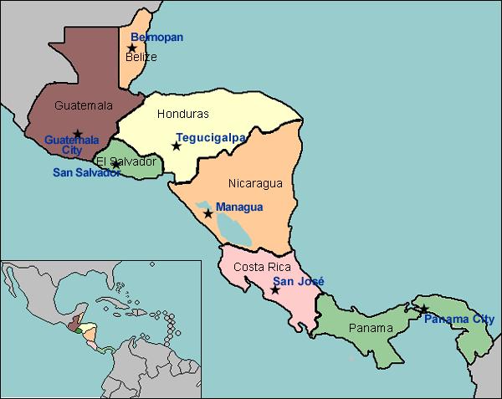
Central America Today
Guided Notes:
Pg.186 in textbook

Slide 2
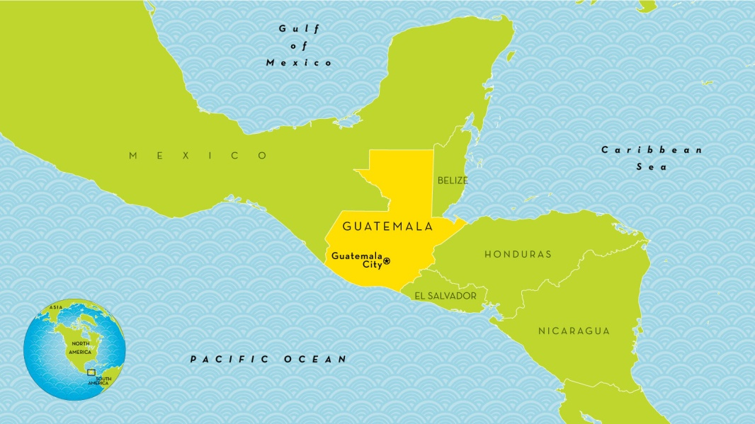
Guatemala
The most populous country in Central
America
The population is more than 12 million people living there.

Slide 3
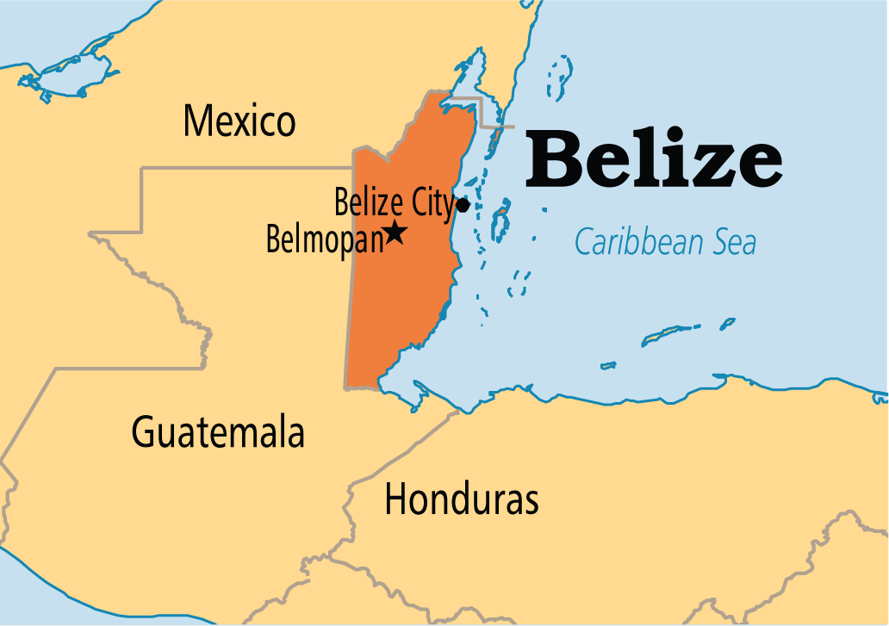
Belize
Belize has the smallest population in Central America.
The country does not have much land
for agriculture.

Slide 4
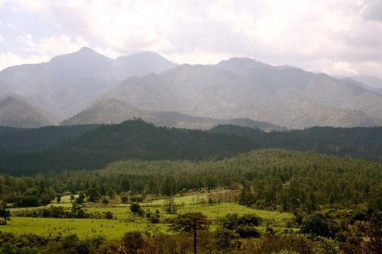
Honduras
Honduras is a mountainous country.
Most people live in mountain valleys and
along the northern coast.

Slide 5
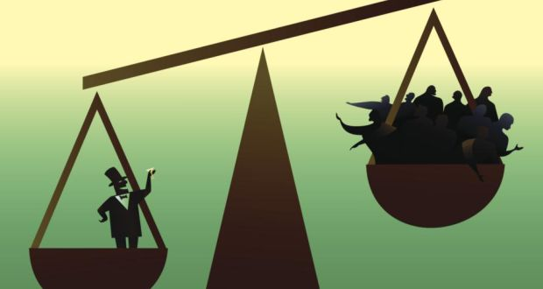
El Salvador
In El Salvador, a few rich families own much of the best land while most people live in poverty.
El Salvador’s people have been working to
rebuild their country since the end of the war in 1992.

Slide 6
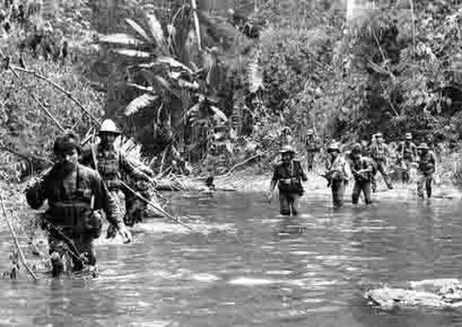
Nicaragua
Nicaragua has been rebuilding since the end of a civil war.
The civil war ended in 1990 when elections ended the rule of the Sandinistas.

Slide 7
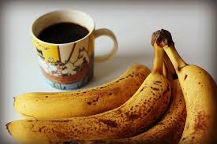
Costa Rica
Agricultural products like coffee and bananas
are important to Costa Rica’s economy.
Many tourists visit Costa Rica’s rich tropical
rain forests.

Slide 8
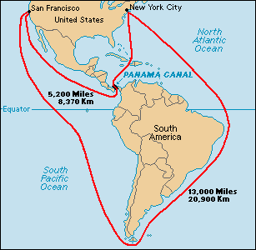
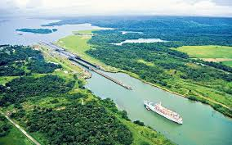
Panama
Panama is the narrowest, southernmost
country of Central America.
The Panama Canal provides a link between the Pacific Ocean, the Caribbean Sea, and the
Atlantic Ocean.

Slide 9
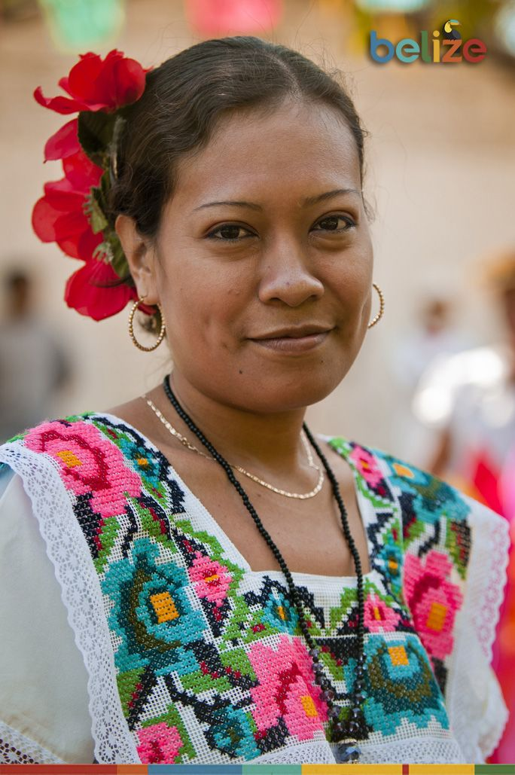
Culture
1) Most of the people in Central America are “mestizos” or people of mixed European or Indian ancestry.

Slide 10
2) People of African ancestry also make up a
significant minority in this region.
3) In some countries in Central America
many people still speak the native Indian
languages.

Slide 11
4) In places that were colonized by England, English is spoken.
5) In most countries Spanish is spoken.

Slide 12
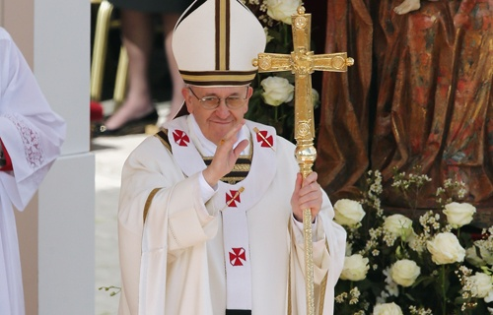
6) Most people are Roman Catholic because Spanish missionaries taught the Indians about Catholicism.
7) Protestant Christians are becoming a large minority in places such as Belize.
8) During festivals, people eat traditional food like
corn, tomatoes, and hot peppers.

Slide 13
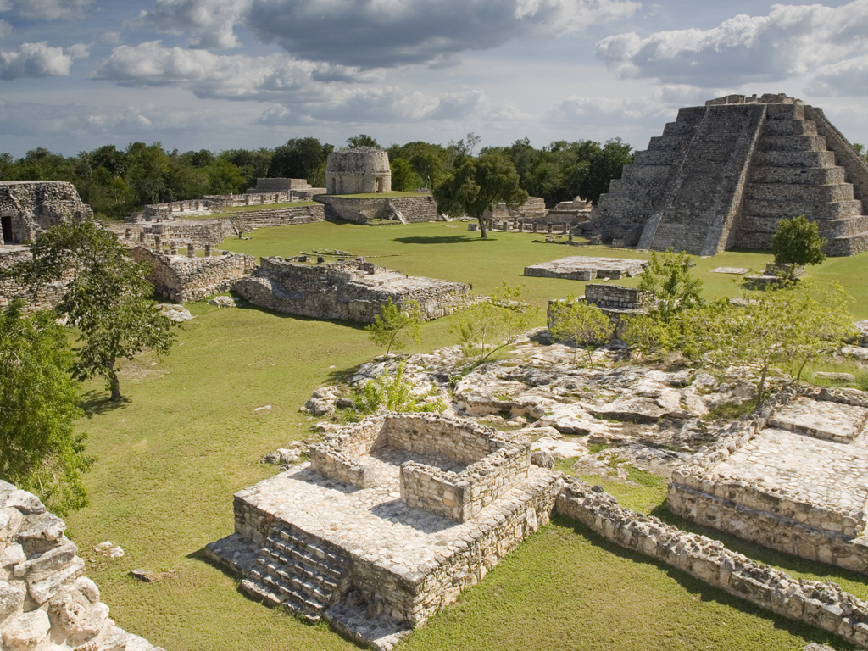
History
In Central America the history was influenced by Maya, Spanish, and the United States. The land in Central America is covered with Maya ruins.

Slide 14
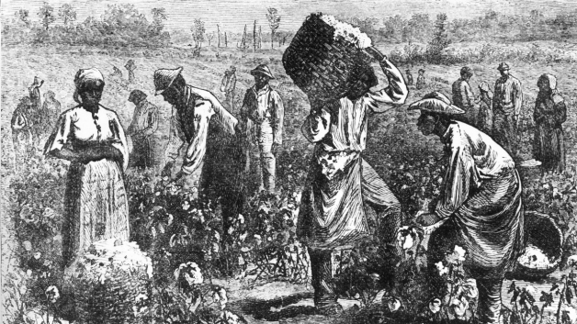
Spain and Britain ruled colonies in Central America in the 1500s. They had many slaves working in the mines and on farms.

Slide 15
Central American Spanish colonies gained independence in 1821.
Spanish officials left, but not much changed because rich people continued to run the country.

Slide 16
Foreign companies came in to Central America to run different businesses. It was good for the economy, but some didn’t like foreign companies.
Recently, these countries have achieved peace.

