Slide 1
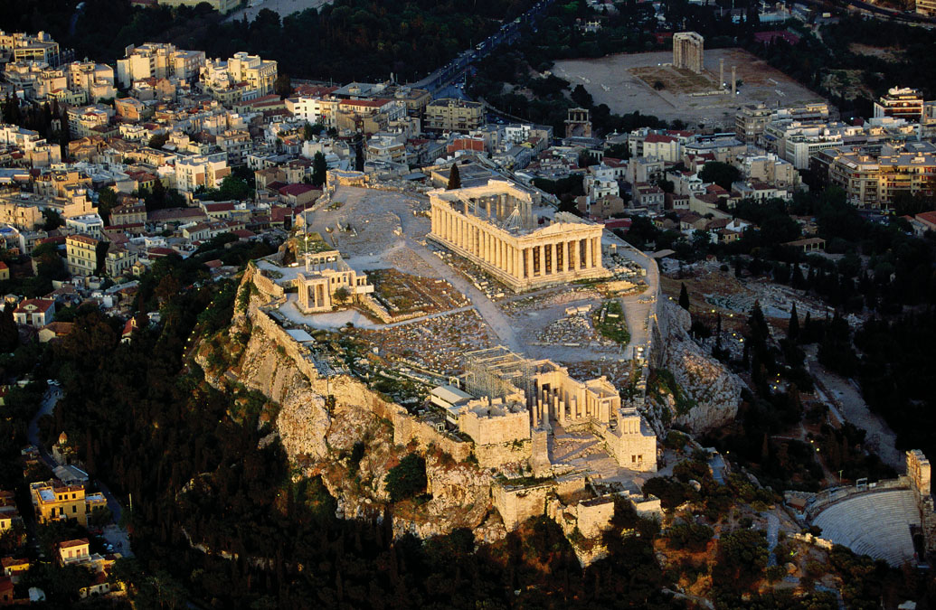
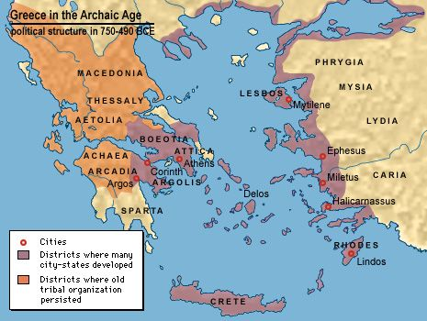
The Polis (Greek City State)
Unit 2

Slide 2
Unit Essential Question
How did the individual city-states, specifically Sparta and Athens, contribute to the development of government?

Slide 3
Unit Vocabulary
Directions: Define each vocabulary term in your notebook
Polis- a Greek city-state
Acropolis- Fortified hill in ancient Greek cities
Agora- Ancient Greek marketplace
Aristocrats- Members of the upper class
Helots- Enslaved people owned by city-states
Perioeci- merchants and artisans in Spartan villages
Oligarchy- Government in which a few people rule
Constitution- written laws used to govern a state
Democratic- Favoring the equality of all people
Magistrates- Judges

Slide 4
Activator
In your journals, list two advantages and two disadvantages of living in a modern city…

Slide 5
Activator Continued
Discussion: What did you come up with and why?
Greeks lived in city-states.
As we progress through this Unit of Inquiry, look for the advantages and disadvantages of life in the Greek city-states and write your thoughts down.
Whenever you come up with an advantage/disadvantage, you can add it to your list

Slide 6
Lesson Essential Question
How was the social and physical structure of a polis unique to each Greek city-state?

Slide 7
Greece
The Geography of Greece (mountainous and surrounded by the sea) kept the communities separated from one another.
They had the same customs and spoke the same language but these people never united together into one country.
People developed a loyalty to the community in which they lived.

Slide 8
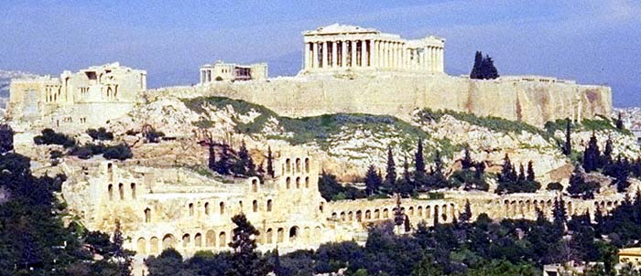
Polis
The Polis or city state was the geographic and political center of Greek life.
Each polis was made up of the surrounding lands around a fortified hill called an acropolis.
At the top of the acropolis, there was a temple of the local patron god that polis.
At the foot of the hill was an open air market place called an agora.

Slide 9
City states
The inner part of the polis became the city, the surrounding area farmed the city state.
Each city state had its own government and laws.

Slide 10
Citizens
Free men who lived in the polis were citizens.
Workers who were NOT born in Greece, women, children, and slaves were not considered citizens of a polis.
As a citizen, Men could:
Vote
Own property
Hold public office
Speak for themselves in court

Slide 11
Citizens
Citizens were expected to:
Take part in government
Defend the polis in times of war
Civic and personal honor were one in the same. The polis gave them a sense of belonging.

Slide 12
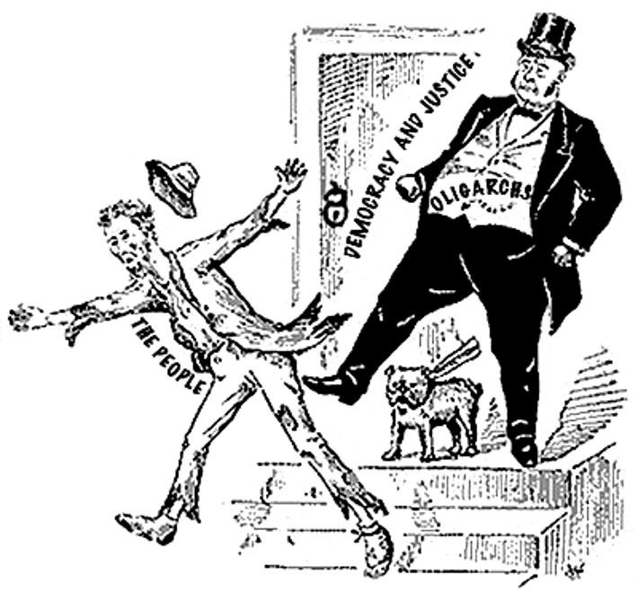
Wednesday, October 12th 2016
Warm-up: What is an Oligarchy?
HW: Study Unit 2 vocabulary terms (yellow paper) and Greek map

Slide 13
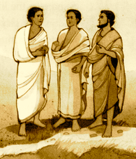
Warm-up Answer
Government in which a few people rule

Slide 14
Political Analytical tools
There are some unavoidable political questions…
What is Politics?
Political relationships- authority or rule exists- power
“Study of the shaping and sharing of power”
Politics, both a science and an art- Must understand World one lives in. Politics is necessarily controversial, uncertain.
Aristotle- concept of self-sufficiency
***almost all associations have a political aspect (and more)

Slide 15
Activation
In your journals, brainstorm what rights and freedoms people would/should expect to have in a society.
When you have thought of a few things and have written them down, turn and share them with your neighbor
Next, we will categorize them as a right or a privilege.
Are there any differences in rights and privileges based on your gender, economic status, race, or any other factors? Are any of these issues controversial?

Slide 16
Monday, October 17th 2016
Warm-up: Using your vocabulary terms for this unit (yellow vocabulary sheet), explain the difference between aristocrats, helots, and perioeci in ancient Greek society.
HW: Creative Journal Writing assignment (due Wednesday)

Slide 17
Warm-up response
Aristocrats were members of the upper class in Greek society. Perioeci were merchants and artisans (skilled workers) in Spartan villages. Helots were enslaved people owned by city-states.
Aristocrats
Perioeci
Helots

Slide 18
Lesson Essential Question
How did the differences between Sparta and Athens influence Greek and world culture?

Slide 19
K-W-L chart (Think-Pair-Share) Topic: Sparta vs. Athens
What do you already Know about Sparta and Athens?
What do you Want to know about Sparta and Athens?
What did you Learn about Sparta and Athens? (This will be filled-in at the conclusion our lesson as our exit summary).

Slide 20
Lesson Essential Question
How did the differences between Sparta and Athens influence Greek and world culture?

Slide 21
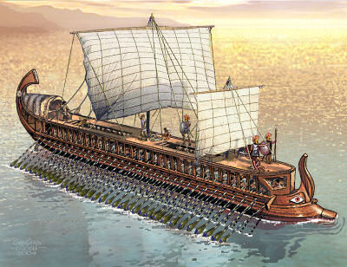
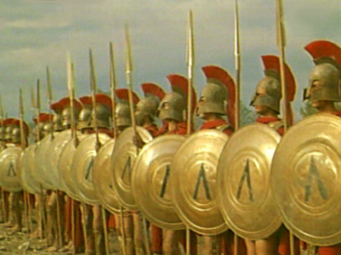
Sparta vs. Athens
Guided Notes

Slide 22
Location
Sparta
South-central region of Greece known as the Peloponnesus
Athens
Northeast of Sparta on the Aegean coast

Slide 23
Military
Sparta
Greatest military power in Greece
Only goal → to be MILITARY STRONG
Kings led the army
Spartan boys were sent to live in military camps when they were seven
Athens
Army and navy
Triremes: warships that had 3 levels or rowers, one above the other
Delian League
-common navy
Played a role in the Persian Wars

Slide 24
Citizenship
Sparta
Only aristocrats were citizens
Helots and perioeci were NOT citizens
Athens
750 B.C. Athenian nobles, merchants, and manufacturers took over the government
594 B.C. Solon prepared a constitution that broke the political power of the rich
He offered citizenship to artisans who were not Athenians
560 B.C. Peisistratus stated that a person no longer had to own land to be a citizen.
Athenian males became citizens at 18 years old.

Slide 25
Babies
Sparta
Newborn babies were examined to see if they were healthy.
If they were healthy, then they were allowed to live.
If they were not healthy, then they were left on a hillside to die.
Athens
In Athens, if a child was not wanted, they were left in a public place to be picked up or adopted as slaves.
This happened more often for girls.

Slide 26
Government
Sparta
Ruled by a king at first
By 800 B.C., aristocrats took over the government and from then on 2 kings ruled at a time (oligarchy)
Assembly -the Assembly was open to all males over 20 years old
passed laws & made decisions about war and peace
each year chose 5 members known as ephors (managers)
Ephors - controlled public affairs and educated young Spartans
Athens
Ruled by a king at first
750 B.C., Athenian nobles, merchants, and manufacturers took over the government, became an Oligarchy
Changes in government
Draco tried to change the government but failed because his punishments were too harsh.

Slide 27
Government
Athens
Changes in government (continued)
594 B.C., Solon took over government and prepared a constitution to break political power of the rich
560 B.C., Peisistratus took over→ he was in favor of the lower classes
Sparta
Council of Elders-helped the ephors
suggested laws to the assembly
served as a high court

Slide 28
Government
Athens
Peisistratus’ sons took over government after his death-soon after, Spartans overthrew their gov’t.
508 B.C., Spartans were overthrown by Cleisthenes, a noble
He put into effect the Western world’s first constitution.
Democratic Constitution, favoring the equality of all people
The Assembly was open to all males over 20 years old.

Slide 29
Government
Athens
Each year, the Assembly elected 10 generals who did the following:
Run the Athenian army and navy
Serve as chief magistrates, or judges.
One of them was named commander-in-chief.
Council of Five Hundred
Council members were chosen each year by lot instead of by vote (2 reasons)
Everyone was smart enough to run for public office.
This gave everyone a chance to serve.

Slide 30
Boys
Sparta (military camps)
Sent to live in military camps at age 7
trained in groups
learned how to read, write, and use weapons
given small amount of food
went barefoot with one cloak to wear
only spoke when necessary
examined every 10 days to check they were not getting fat
Athens
It was required that citizens educated their sons
No public schools
Had a tutor
attended private school
starting at 7, they studied writing, math, and music
memorized Homer’s work and other famous Greek poets
practiced sports

Slide 31
Men
Sparta
expected to marry at age 20
couldn’t have a household of their own
expected to live and eat in military barracks—shared expenses with other soldiers
could retire from army when they turned 60
Athens
became citizens at age 18
went to the temple of Zeus
At the temple, they took an oath of citizenship in front of family and friends
→promised to do the following:
help make Athens a better place in which to live
be honorable in battle
follow the constitution
respect their religion

Slide 32
Women
Sparta
more freedom than women of other Greek city-states
mixed freely with men
enjoyed sports (wrestling, racing)
told their men to come home with their shields if the men were sent into battle
Athens
spent most time at home performing household duties
didn’t go out without a chaperone
only went out to visit other women or attend religious festivals
never spoke to men on the street or entertained their husbands’ friends

Slide 33
Social Classes
Sparta
upper class settled near the agora
upper class→ aristocrats (*trained for the army and war)
Perioeci (merchants and artisans who lived in the villages) (*worked)
-they were neither enslaved people nor citizens
Helots (enslaved people owned by the city-states who worked the land) (*worked)
Athens
upper class settled near the agora
Lower class→ farmers
Upper-class Athenians(nobles, merchants, and manufacturers) made reforms to resist an uprising against the government due to fights between the nobles, farmers, artisans over land ownership

Slide 34
Culture-Jobs/Arts/Entertainment
Sparta
Helots and perioeci—enslaved people, merchants, and artisans
sports
resisted change so new ideas wouldn’t weaken their way of life (farming society dependent on slaves)
only goal→ to be military strong!!!
Athens
merchants, artisans, and farmers
Sports
school
literature, art, , philosophy, and music reached new heights during Pericles’ reign
strong religious beliefs and respect for democracy

Slide 35
Role in the Persian Wars
Sparta
Battle of Thermopylae
300 Spartans remained….
…but were then killed at the pass when a Greek traitor informed the Persians where the Greeks waited.
Athens
sent warships to help Ionia revolt after their defeat by the Persians
Battle of Marathon (490 B.C.)
Greeks won
Battle of Thermopylae (480 B.C.)
Greeks lost
Battle of Salamis
Greeks won (lighter, faster ships defeated the Persian fleet)
Battle of Plataea (479 B.C.)
Greeks won
all victories were due to their powerful navy

Slide 36
Delian League
Sparta
one of the few city- states that did not join
Athens
formed a defensive league, or protective group, (Delian League) since Persians still ruled Ionia
once a city-state became a League member, it could not withdrawal unless all members agreed
common navy
ships built and crewed by Athenians but costs paid by other city-states
Athens gained more and more power over time

Slide 37
Delian League
Athens
turned into the Athenian Empire
Pericles (general/main leader at the time) known as the “first citizen” of Athens
He dreamed of Athens as being the most beautiful, perfect city
He rebuilt palaces and temples on the Acropolis
The Parthenon (temple of Athena)
The Long Walls—connected Athens to Piraeus (seaport)
art, philosophy, and literature reached new heights during this time

Slide 38
Decline
Sparta
Sparta ruled Greece after the Peloponnesian War—Spartans were harsh rulers who angered the other Greeks
371 B.C., Thebes overthrew Spartan rule
Athens
30-year Peloponnesian War was the start of the end-404 B.C. Athens surrendered to Sparta
War and plague killed many Athenians and thousands of Athenian men became mercenaries (hired soldiers) who left home.
Athens revolted and set up a democracy again, but they didn’t have the power they once had

Slide 39
Lesson Essential Question
How did other Greek city-states contribute to the development of ancient Greece?

Slide 40
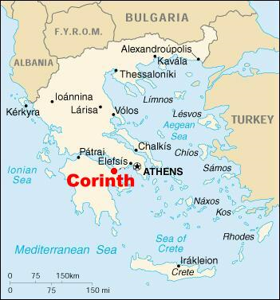
Corinth
Corinth was a powerful city-state.
It was located on the coast and was ruled by a king.

Slide 41
Corinth
For a while, they had a huge problem with unemployment.
They solved this problem by creating public works projects, by building aqueducts which were pipes that brought fresh water into the city.
This put people to work, and solved another problem, the need for enough safe drinking water to provide to their growing population.

Slide 42
Corinth
They created their own coins.
They opened places where people could trade their money for Corinthian money so they could pay for goods.
This was not a free service. There was a charge for this. Corinth was one of the largest centers of trade in ancient Greece.
So the city made a great deal of money from their money exchange program.

Slide 43
Corinth
Corinth felt their schools were as good as those in Athens.
All boys went to military school for at least two years after high school.

Slide 44
Corinth
Corinth worked at being a leader in the ancient Greek world
They were highly respected by other Greek city-states.
The people of Corinth were very proud of their city-state.

Slide 45
Argos
There was a harbor near the city-state of Argos, but Argos itself was built on a plain.
It was very hot in the summer and cold in the winter. The soil was poor.
They became leaders in trade.
Because they traded with other Greek city-states, they invented their own coinage.

Slide 46
Argos
Like all the Greek city-states (except for Sparta), the people of the city-state of Argos built sculptures of athletes with perfect bodies and huge muscles.
They wrote plays.
They wrote poetry.
Their musicians performed in the open air arenas.
They loved the arts.

Slide 47
Argos
Most Greek city-states, like Argos, were ruled by a king.

Slide 48
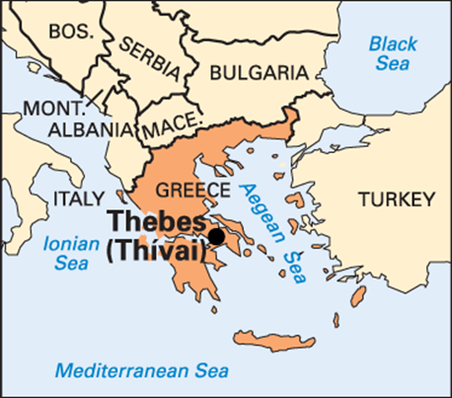
Thebes
It was a major rival of ancient Athens, and sided with the Persians during the 480 BC invasion under Xerxes.
Theban forces ended the power of Sparta.
Prior to its destruction by Alexander in 335 BC, Thebes was a major force in Greek history, and was the most dominant city-state at the time of the Macedonian conquest of Greece.

Slide 49
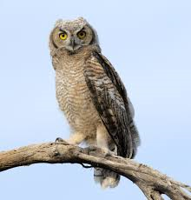
Poetry for thought (The Greeks loved it)
A wise, old owl sat on an oak–
The more he saw, the less he spoke,
The less he spoke, the more he heard,
Why can’t we all be like that wise, old bird?
-Old English Poem, Circa 1875,
origin unknown

