Slide 1
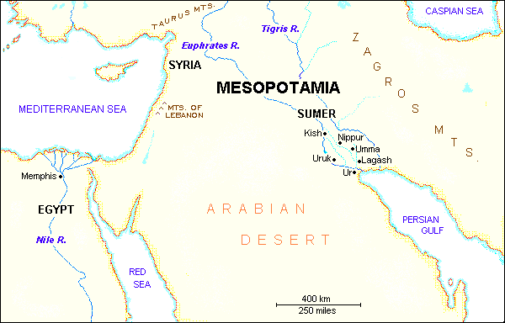
Unit 2: The Fertile Crescent
Part 1: Mesopotamia

Slide 2
Lesson Essential Question – By controlling the environment, how did Early Mesopotamians develop the world’s first civilization?

Slide 3
A. Locate and label items on the Mesopotamia map.

Slide 4
B. Where did the earliest civilization develop?
The earliest known civilization developed between the Tigris and Euphrates rivers.

Slide 5
C. What was the “land between the rivers” called in ancient times?
In ancient times, it was called Mesopotamia.

Slide 6
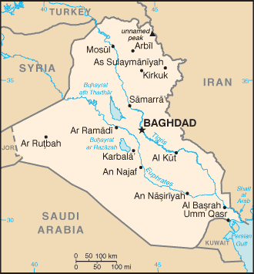
D. What is the “land between the rivers" called today?
Today, it is called Iraq.

Slide 7
E. Why was Mesopotamia called the “cradle of civilization”?
The people of Mesopotamia developed so many new ideas.

Slide 8
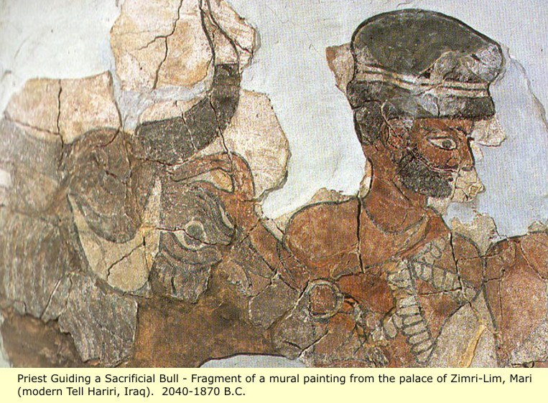
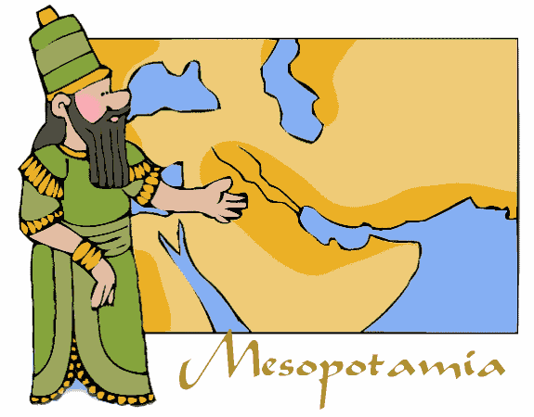
F. Who were the Sumerians?
They were a short, stocky, black-haired people who settled in southern Mesopotamia.

Slide 9
G. Sumerian civilization is the earliest known civilization on Earth.

Slide 10
H. The Sumerians were the first people to do what?
The Sumerians were the first people to control their environment.

Slide 11
I. What did the Tigris and Euphrates do each spring?
The rivers would flood.

Slide 12
J. How did the Sumerians control their environment?
  They built levees to keep back the flood waters.
  Define levee: Raised areas of soil
  During the summer, the land became dry.
  They used water from the canals to irrigate, or water, their crops.
  Their crops included barley, wheat, sesame, flax, fruit trees, date palms, and vegetables.

Slide 13
K. How did the flooding of the Tigris and Euphrates Rivers make the Sumerians more organized?
The irrigation system took much planning. People had to learn how to work together. The Sumerians set up governments to make laws so they would know what was expected of them.

Slide 14
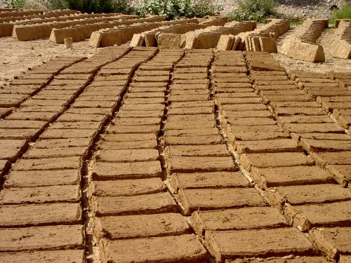
L. What building materials did the Sumerians use to build their cities? Why?
They used sun-dried, mud-brick because there was little stone and timber to build with.

Slide 15
City-States
Lesson Essential Question – How was Sumerian life similar or different from the lives of earlier people?

Slide 16
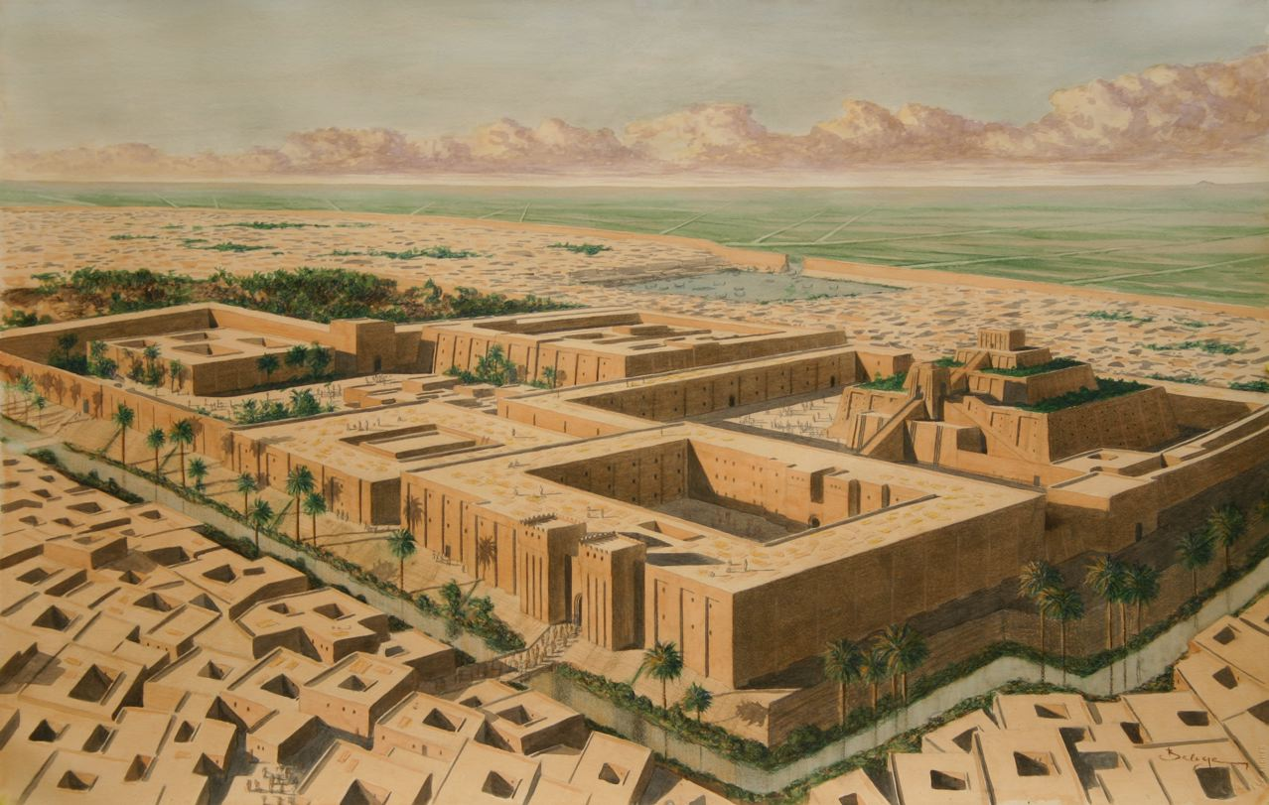
M. Define city-state:
a city and the surrounding farmland

Slide 17
N. Describe a Sumerian city-state:
Walls – Each city was surrounded by a wall of sun-dried brick
Gates – The wall had bronze gates. Gates were open during the day and closed at night.
Streets – Narrow, winding streets led to the city center.
Upper Class – Priests and merchants; lived near the city center; two-story homes
Middle Class – government officials, artisans, shopkeepers; one-story homes
Lower Class – farmers, unskilled workers, and people who made their living by fishing; smaller one-story homes

Slide 18
O. Define artisan:
skilled worker

Slide 19
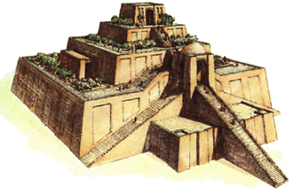
Religious and Family Life

Slide 20
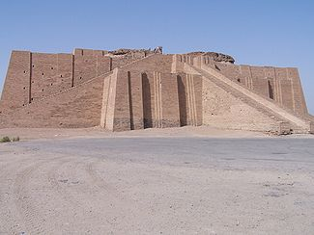
P. Define ziggurat:
Mesopotamian temple

Slide 21
Q. Where was the ziggurat located?
They were located at the center of each city.

Slide 22
R. Describe what a ziggurat looked like:
It consisted of a series of square levels. Each level was smaller than the one below.

Slide 23
S. The courts and ziggurat were the center of Sumerian life. List what activities took place at the ziggurat and courts.
  Artisans worked there.
  Children went to school there.
  Farmers, artisans, and traders stored their goods there.
  The poor were fed there.
  All great events were celebrated there.

Slide 24
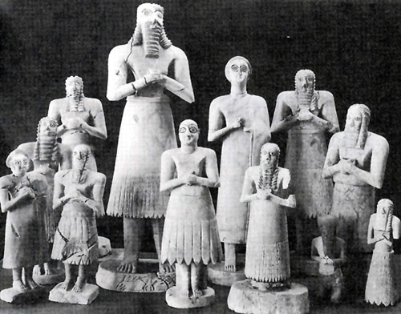
T. Describe Sumerian religion.
  The Sumerians believed that all the forces of nature, like rain and flooding, were alive.
  Since they could not control these forces, the Sumerians viewed them as gods.

Slide 25
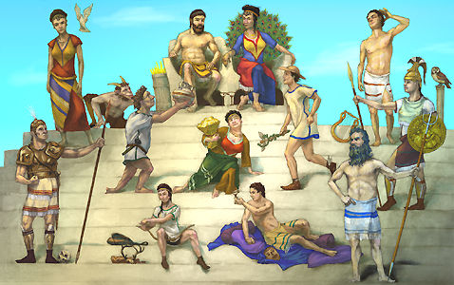
U. Define polytheism:
Polytheism is the belief in many gods and goddesses.

Slide 26
V. Describe Sumerian priests.
  The Sumerians thought that only the priests knew the will of the gods.
  Sumerian priests were very powerful.
  The priests controlled and administered all the land, and they ran the schools.

Slide 27
W. Describe Sumerian schools.
  They were only for the sons of the rich.
  Poorer boys either learned a trade, like pottery or metal working, or worked in the fields.
  Schools were located near the ziggurat and courts.
  They were known as tablet houses because their main purpose was to teach students how to write.

Slide 28
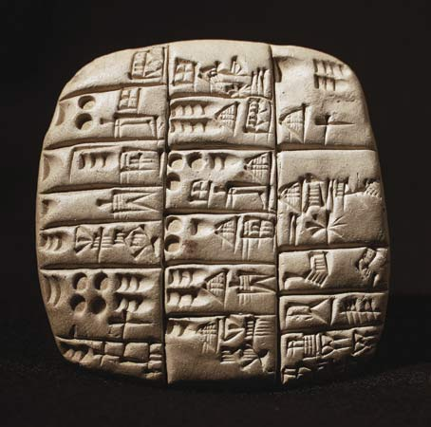
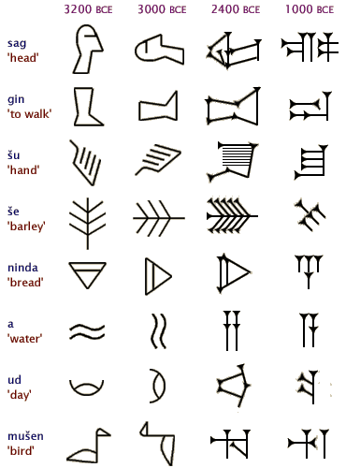
X. Define cuneiform:
Sumerian writing

Slide 29
Y. Why was writing developed?
  People had to keep track of business deals.
  When people lived in villages, people could remember business transactions.
  As cities grew, there were too many people and goods to remember.

Slide 30
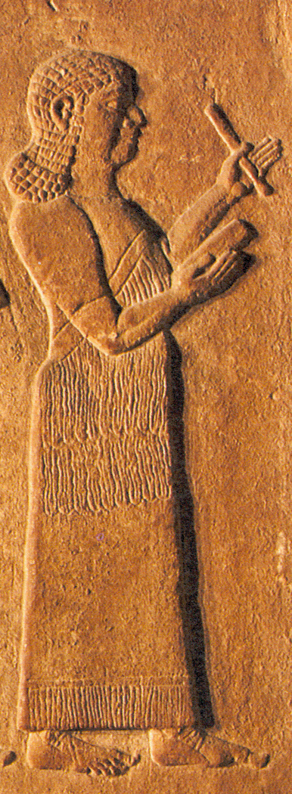
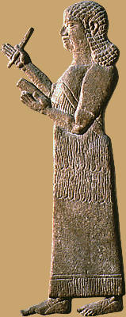
Z. Define scribe:
A scribe is a writer.

Slide 31
AA. Where did scribes work?
Scribes would work at the temple, the palace, the government, or the army. Some scribes worked for merchants or set up their own business as public writers.

Slide 32
BB. What was life like for Sumerian women?
  Women did have some rights.
  They could buy and sell property.
  They could run businesses and own and sell enslaved people.

Slide 33
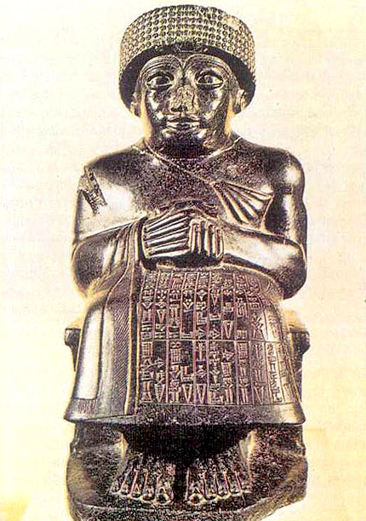
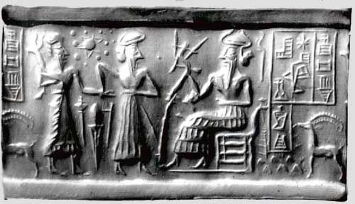
Priest-Kings

Slide 34
CC. At first, Sumer was ruled by priests who were also kings of the city-state.

Slide 35
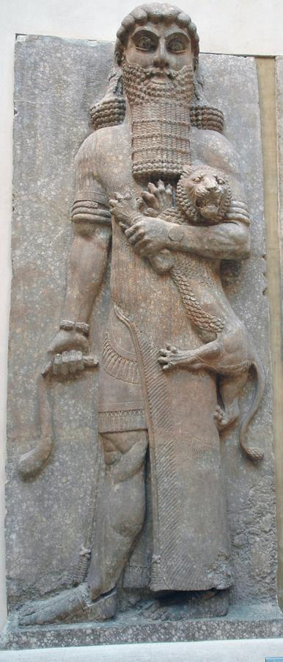
DD. Who was Gilgamesh?
  Gilgamesh was one of the most famous priest-kings.
  The tales about Gilgamesh are the oldest in the world.
  One tale is similar to the story of Noah and the ark.

Slide 36
EE. Sumerian priest-kings received their advice from an assembly of free men. When war broke out, the assembly would choose one of its members to serve as a military leader. As time went on, these leaders stayed in charge even after the peace returned. By about 3000 B. C., they took the place of priests as permanent kings. At the same time, kingship became hereditary, or passed down from parent to child.

Slide 37
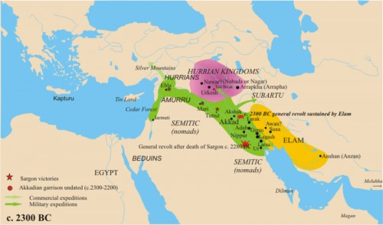
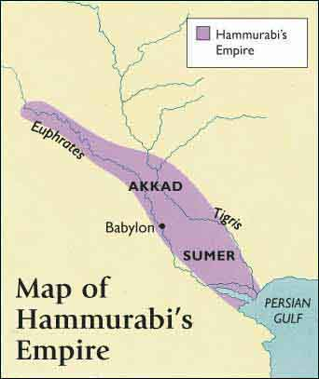
Later Mesopotamian Empires

Slide 38
FF. About 2400 B. C., the power of Sumer began to fade. New civilizations began to develop in Mesopotamia.

Slide 39
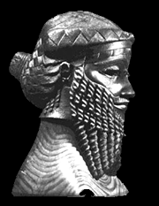
Sargon I (p. 61)

Slide 40
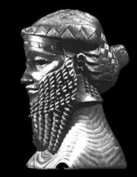
GG. Who was Sargon I? What did Sargon I create?
Sargon I was the ruler of northern Mesopotamia. He conquered Sumer and he created the world’s first empire.

Slide 41
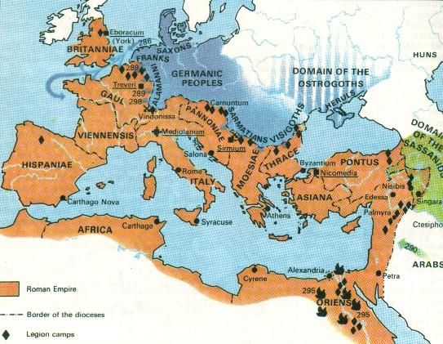
HH. Define empire:
An empire is a group of states under one ruler.

Slide 42
Hammurabi of Babylon
Lesson Essential Question– Why was Hammurabi’s code important to future civilizations?

Slide 43
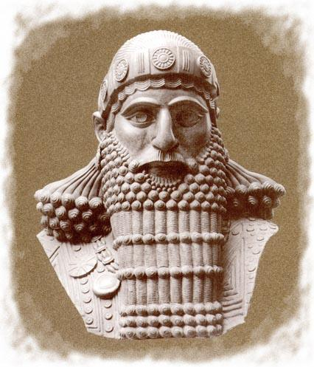
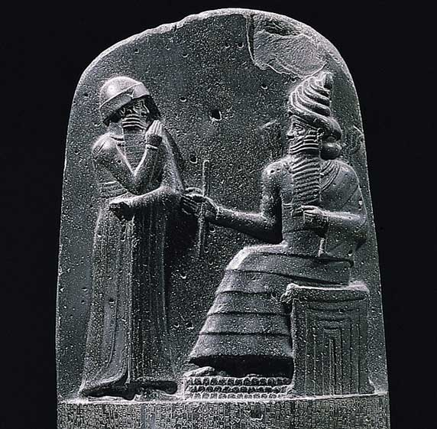
II. Who was Hammurabi?
He was a Babylonian king. He conquered Akkad and Sumer and became ruler of a great new empire.

Slide 44
JJ. What changes, or reforms, did Hammurabi make that were important?
  He improved irrigation systems by building and repairing canals.
  He changed religion by raising the god of Babylon above all other gods. This is going to unite the people.
  He reorganized the tax system.
  Hammurabi began a government housing program.

Slide 45
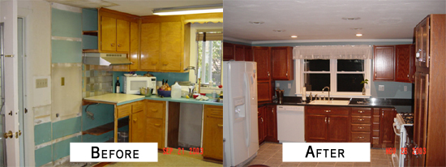
KK. Define reform:
A reform is a change or an improvement.

Slide 46
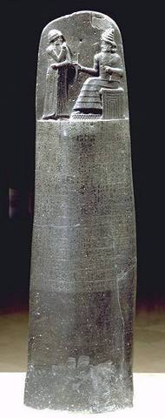
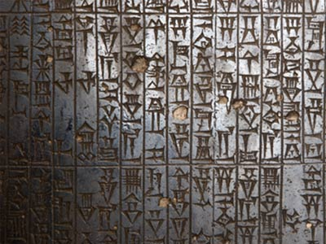
LL. What reform was Hammurabi best known for?
Code of Law or Code of Hammurabi

Slide 47
MM. How did Hammurabi create his code of law?
At first, each city-state had its own code. Hammurabi took what he felt were the best laws from each code, and created one code that everyone in the empire was to live.

Slide 48
NN. What were some of the main points of Hammurabi’s code of law?
Judges and witnesses who were not honest were punished.
A person was believed innocent until proven guilty.
Once proven guilty, a person was punished.
Punishments ranged from fines to death.
Members of the upper class generally were punished more severely.
An eye for an eye was one law.

Slide 49
OO. What was Hammurabi’s reign known as?
It was known as the Golden Age of Babylon

Slide 50
Contributions
Lesson Essential Question – How did the contributions of the Ancient Mesopotamians impact future civilizations?

Slide 51
OO. What was the result of Mesopotamia’s influence on other civilizations?
Inventions, customs, and ideas of the Sumerian and Babylonian cultures were copied and improved upon by other peoples.

Slide 52
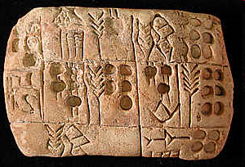
OO. What was the result of Mesopotamia’s influence on other civilizations?
  1. Writing – The oldest written records known are Sumerian. The Sumerians were the first people to write down their laws. Sumerian cuneiform became the model for other people’s writing.

Slide 53
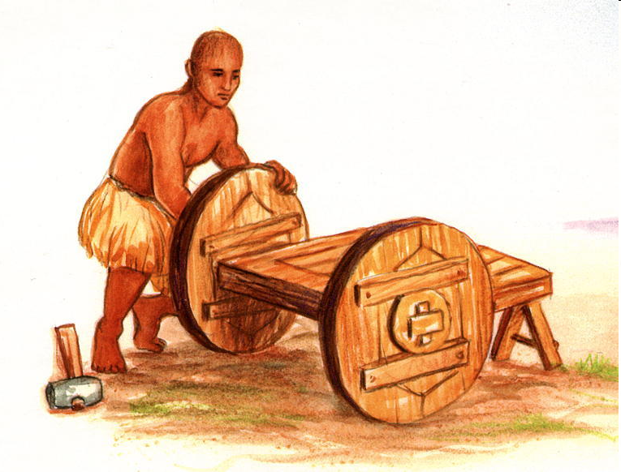
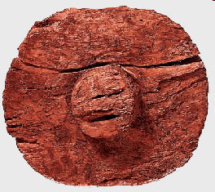
OO. What was the result of Mesopotamia’s influence on other civilizations?
  Wheel – Helped transportation

Slide 54
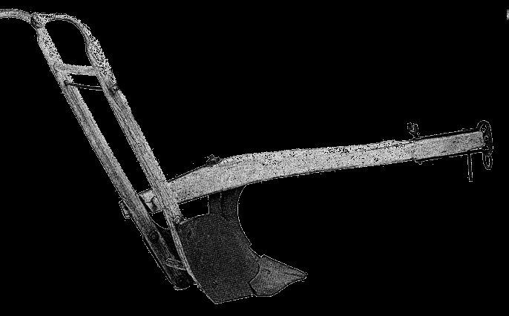
OO. What was the result of Mesopotamia’s influence on other civilizations?
  Plow – Made it possible for farmers to grow more food with less effort

Slide 55
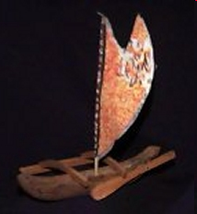
OO. What was the result of Mesopotamia’s influence on other civilizations?
  Sailboat – Replaced muscle power with wind power

Slide 56
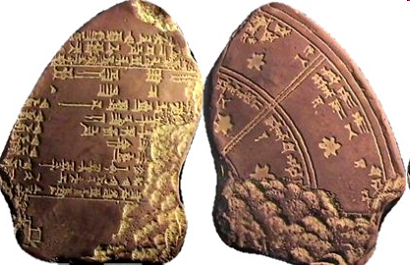
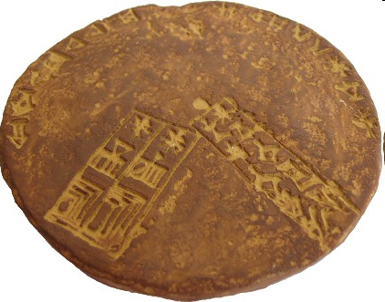
OO. What was the result of Mesopotamia’s influence on other civilizations?
  Calendar – The people of Mesopotamia developed a 12-month calendar based on the cycles of the moon. The calendar marked the times for religious festivals and planting.

Slide 57
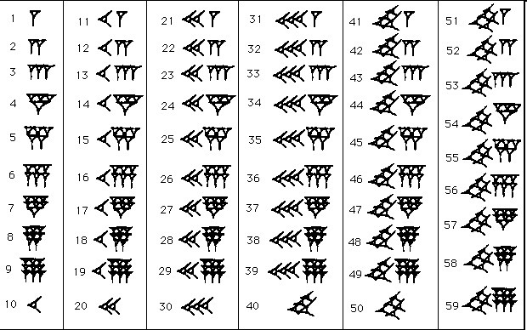
OO. What was the result of Mesopotamia’s influence on other civilizations?
  Math – The people developed a number system based on 60. From this came the 60-minute hour, 60-second minute, and the 360-degree circle.

Slide 58
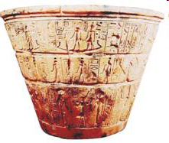
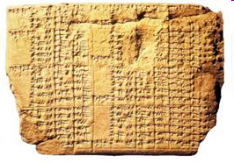
OO. What was the result of Mesopotamia’s influence on other civilizations?
  Water Clock – A clock that was operated by controlled drops of water.

